Slide 1
Chapter 17 Binocular Stereo Vision
Prof. Lin ZHANG
School of Computer Science and Technology
Tongji University

Slide 2
Outline
Rectified binocular system
Calibration of a physical binocular system
Stereo matching and disparity map computation
3D reconstruction based on the disparity map

Slide 3
Rectified binocular system
光轴
光轴
f_{rect} is the focal length (unit: pixel) of the intrinsics matrix
δ is the physical length of each pixel (unit: mm/pixel)
(c_{rect-x}, c_{rect-y}) is the position of the principal point on the imaging plane (unit: pixel)
b (unit: mm) is the distance between the two camera centers
u_{l}
v_{l}
(c_{rect-x}, c_{rect-y})
(c_{rect-x}, c_{rect-y})
z=f_{rect}δ
z=f_{rect}δ
Cam_{rect-l}
Cam_{rect-r}

Slide 4
Rectified binocular system
Rectified binocular system is a “virtual” system; it can simplify the depth estimation
By moving O_{l}-xyz b(mm) along the x-axis, we get the O_{r}-xyz coordinate system
Cam_{rect-l} and Cam_{rect-r} have the same intrinsics matrix,
The two images I_{rect-l} and I_{rect-r} of a rectified binocular system are row-aligned. That means, if u_{l}(u_{l}, v_{l}) and u_{r}(u_{r}, v_{r}) are the images of the same spatial point on I_{rect-l} and I_{rect-r}, we should have v_{l}=v_{r}

Slide 5
Rectified binocular system
Depth calculation under the rectified binocular system
With the rectified binocular system, given a spatial point p_{w}, it is easy to obtain its depth w.r.t to the left camera, i.e., p_{w}’s z-value with respect to the coordinate system O_{l}-xyz
Suppose that p_{w}’s image on I_{rect-l} is (x_{l}, y), and its image on I_{rect-r} is (x_{r}, y)
Projecting all the elements on the plane O_{l}-xz. On O_{l}-xz, the projection of p_{w} is . Obviously, ’s z-value w.r.t to the coordinate system O_{l}-xz is p_{w}’s z-value with respect to the coordinate system O_{l}-xyz

Slide 6
Rectified binocular system
The physical distance between two image pixels (x_{l}, y) and (x_{r}, y) is,
Then we have,
x_{l}
c_{rect-x}
c_{rect-x}
x_{r}
Disparity of p_{w}
f_{rect}δ
f_{rect}δ
To get the depth map associated to I_{rect-l}, we need to get the disparity map of I_{rect-l}
With the rectified binocular system, to compute the depth of a 3D point with respect to the camera, only its disparity needs to be known

Slide 7
Rectified binocular system
As we have said, the rectified binocular system is a “virtual” system
Given a real physical binocular system, is there any way to get its associated rectified version?
We need to perform calibration to the physical binocular system; with the extrinsics and the intrinsics known, its rectified version can be derived

Slide 8
Outline
Rectified binocular system
Calibration of a physical binocular system
Stereo matching and disparity map computation
3D reconstruction based on the disparity map

Slide 9
Calibration of a physical binocular system
Consider a physical binocular system. The left camera is cam_{l}, and its camera coordinate system is C_{l}; the right camera is cam_{r}, and its camera coordinate system is C_{r}.
The extrinsics of such a physical binocular system are,
For a 3D point, if its coordinate w.r.t. to C_{l} is p_{l} and its coordinate w.r.t. C_{r} is p_{r}, then p_{l} and p_{r} should satisfy,
By calibration, our purpose is to get R and t

Slide 10
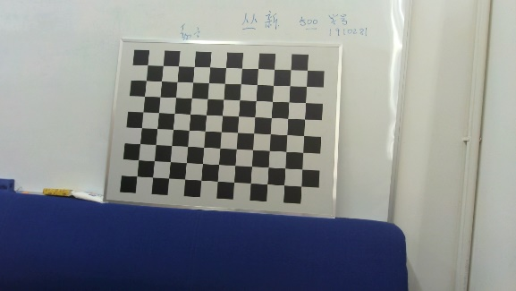
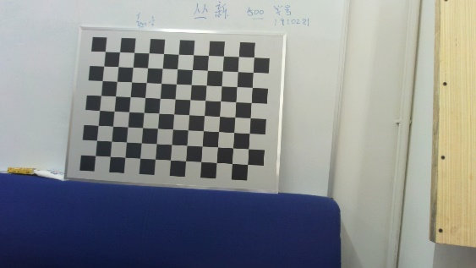
Calibration of a physical binocular system
For binocular system calibration, we also need to resort to the checkerboard
Collect m pairs of binocular images
the left image
the right image
A pair of binocular images

Slide 11
Calibration of a physical binocular system
z
p
y
(R_{li}, t_{li})
O
(5)
x
(R_{ri}, t_{ri})
By comparing (3) and (5), we have
z
x
,
O_{l}
y
O_{r}
C_{l}
(R, t)
C_{r}
z
y
x
(1)
(2)
(6)
(3)
(4)

Slide 12
Calibration of a physical binocular system
where are the parameters that need to be optimized
u_{lij} is the projection of p_{j} onto the left image of the ith binocular image pair
u_{rij} is the projection of p_{j} onto the right image of the ith binocular image pair
are the extrinsics of the left camera w.r.t. to the world coordinate system when taking the ith binocular image pair

Slide 13
Calibration of a physical binocular system
which is a typical nonlinear least-squares problem and can be used by using techniques introduced in Chapter 9

Slide 14
Outline
Rectified binocular system
Calibration of a physical binocular system
Stereo matching and disparity map computation
3D reconstruction based on the disparity map

Slide 15
Stereo matching and disparity map computation
When the extrinsics and the intrinsics of a physical binocular system are known, its associated rectified binocular system can be constructed
To get the corresponding depth map to the left rectified image I_{rect-l}, we need to at first extract its disparity map
We need to know the matching relationships among pixels on I_{rect-l} and I_{rect-r}
For a point u_{l}(x_{l}, y₀) on I_{rect-l}, how to find the matching pixel u_{r} on I_{rect-r}?
Since I_{rect-l} and I_{rect-r} are row-aligned, u_{r} can only happen on the y₀ row of I_{rect-r}

Slide 16
Stereo matching and disparity map computation
On I_{rect-l}, take a patch A round u_{l}. Traverse each position of y₀ row on I_{rect-r}. For the position (x_{i}, y₀) on I_{rect-r}, take a patch B_{i} around (x_{i}, y₀)
Figuring out the position i* whose local patch has the least distance to A,
is u_{r} we want to find, i.e.,
Note: in implementation, usually the matching is not conducted on the raw images but on the partial derivative images, for example, the results of Sobel operators; there are also some algorithms to postprocess the raw disparity map to make it more robust, such as the weighted least-squares method^{[1]}
[1] MIN D, CHOI S, LU J, et al. Fast global image smoothing based on weighted least squares[J]. IEEE Trans. Image Processing, 2014, 23(12): 5638-5653.

Slide 17
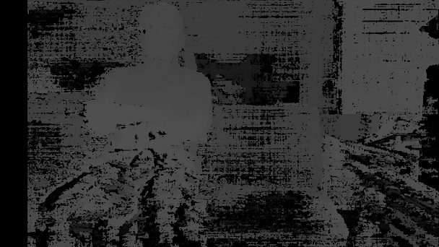

Stereo matching and disparity map computation
The raw disparity map
The disparity map with weighted least-squares postprocessing

Slide 18
Outline
Rectified binocular system
Calibration of a physical binocular system
Stereo matching and disparity map computation
3D reconstruction based on the disparity map

Slide 19
3D reconstruction based on the disparity map
With the rectified binocular system, suppose I_{rect-l} is its left image and u(x, y) is one pixel on I_{rect-l} and its disparity is known as d. The 3D point in space corresponding to u is p. Now let’s compute the coordinate of p w.r.t. the coordinate system C_{rect-l}
Suppose x_{n}=(x_{n}, y_{n}, 1)^{T} is the point on the normalized retinal plane of Cam_{rect-l} corresponding to u. We can have
p’s depth value (z value) w.r.t. C_{rect-l} is

Slide 20
3D reconstruction based on the disparity map
p’s coordinate w.r.t. C_{rect-l} is,
The homogeneous form of p’s position w.r.t. C_{rect-l} is,
or
Notice that,
Denote

Slide 21
3D reconstruction based on the disparity map
is the 3D point w.r.t C_{rect-l} corresponding to the pixel u of the left rectified image I_{rect-l}
Its normal 3D coordinate is,
For any pixel u(x, y) on the left image I_{rect-l} of the rectified binocular system, if know its disparity d, then, the spatial point p (corresponding to u)’s coordinate w.r.t. the camera coordinate system of the left rectified camera is,

Slide 22


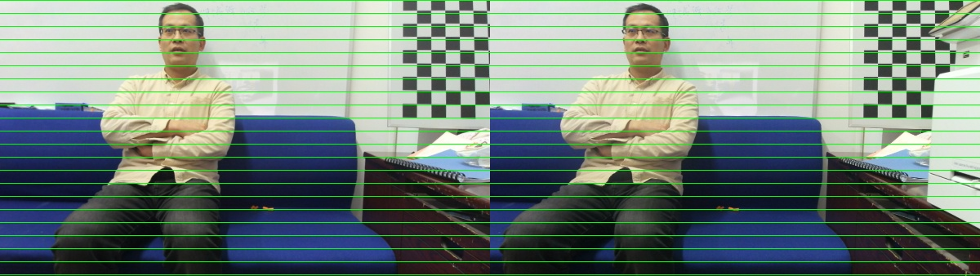
3D reconstruction based on the disparity map
An example
Original image pair
Rectified image pair (they are row-aligned)
depth map with weighted least-squares postprocessing
raw depth map

Slide 23
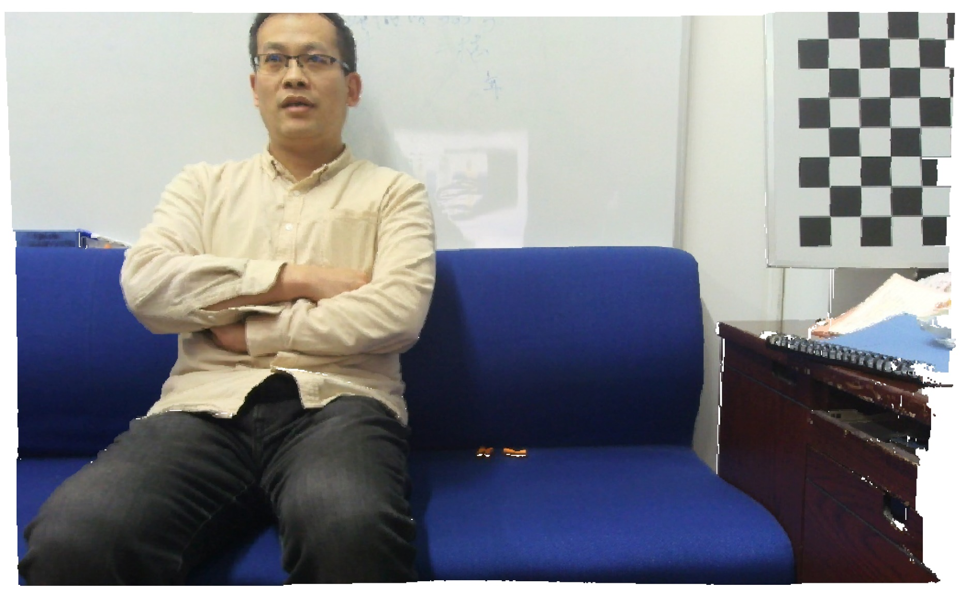
3D reconstruction based on the disparity map
An example
The RGB-D point cloud

Slide 24


